Slide 1
Pie Chart CTEC 298 Neresha Miller Professor Bemley

Slide 2
What is a pie chart?
A pie chart is a circular graph divided into slices.
Each slice represents a proportion or percentage of a whole.
Useful for showing how categories compare within a dataset.
One of the most common statistical visualization tools.

Slide 3

When Would a pie chart be used?
Quick visual interpretation
Market share, Demographic breakdowns, budget distribution , etc.
Help identify dominant categories
How a whole is divided into parts

Slide 4
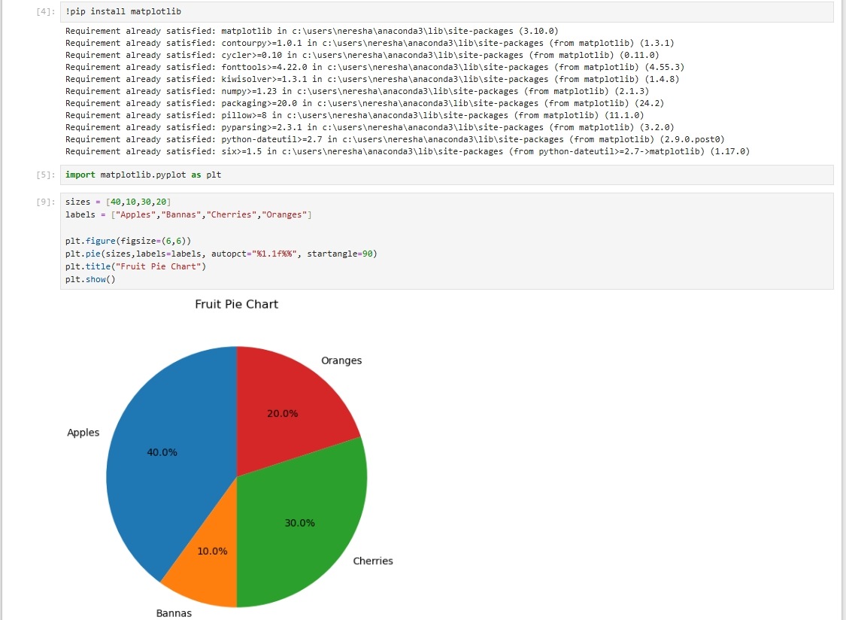
Python Code/ Plot Graphic

Slide 5

​Strengths and Limitations
Strengths:
Easy to interpret
Visually appealing
Good for simple datasets
Limitations:
Hard to compare slices that are close in size
Not ideal for large datasets
Doesn’t show trends over time

Slide 6
Summary
Pie charts show proportions of a whole
Matplotlib makes them easy to generate
Best used for clear, simple category comparisons
Avoid when data is too complex

Slide 7
References
Edureka (2017, April 19). Python Matplotlib Tutorial | Matplotlib Tutorial | Python Tutorial | Python Training
John Hunter, Darren Dale, Eric Firing, Michael Droettboom (2012-2025) https://matplotlib.org/stable/api/_as_gen/matplotlib.pyplot.pie.html

